Slide 1



Netflix Data Analysis
By: Niket Talikoti

Slide 2

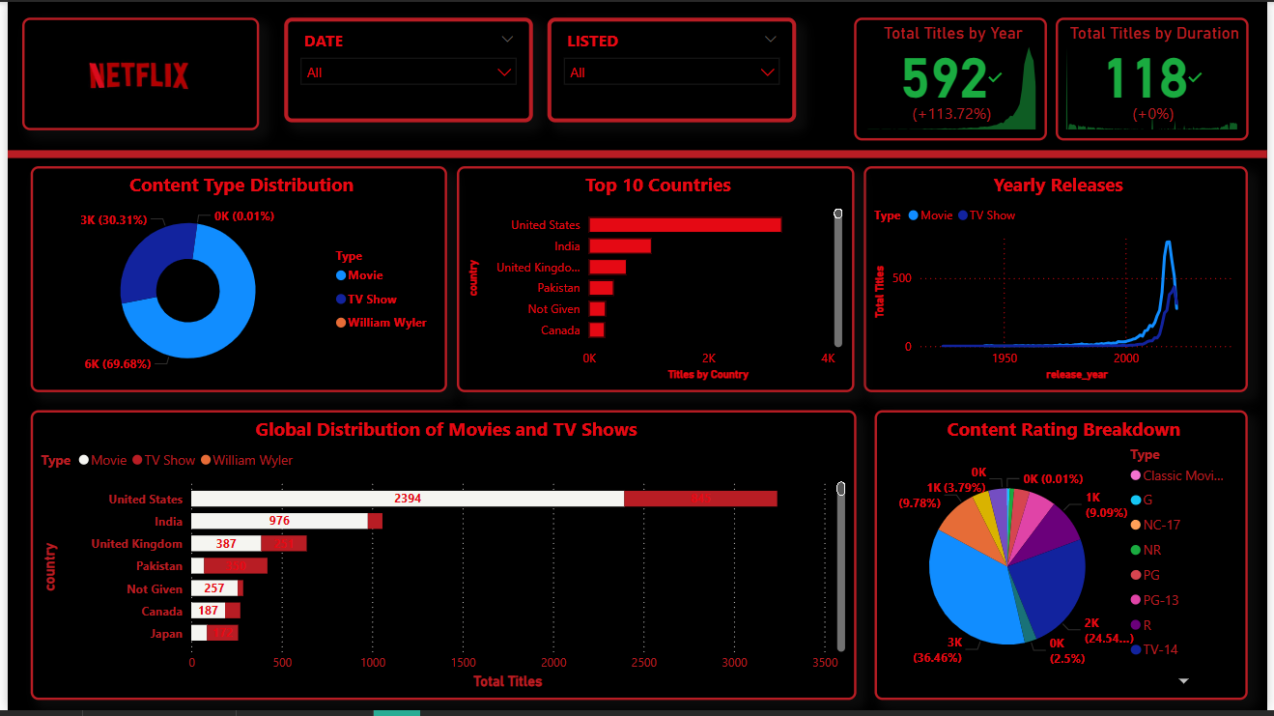
Netflix Analysis Dashboard

Slide 3

CONTENTS
1. Objective of the Analysis
2. Key Metrics & KPIs
3. Country & Genre Analysis
4. Yearly Trend
5. Interactivity & Filters
6. Conclusion & Recommendations

Slide 4


Objective of the Analysis
1
Content Distribution
2
Genre Patterns
Analyze Netflix’s content distribution across movies and TV shows
Discover genre and rating patterns among titles
3
Content Sourcing
4
Trends in Additions
Understand content sourcing by country
Identify trends in content additions over time
5
Strategic Recommendations
Provide recommendations for content and strategic planning

Slide 5






Key Metrics & KPIs
Total Titles
Content Split
Top Ratings
analyzed: [Insert Number]
Majority are Movies, fewer are TV Shows
TV-MA, TV-14, R
Popular Genres
Common Movie Duration
TV Shows
Drama, Documentaries, Comedy
90–120 minutes
Mostly short series (1–2 seasons)

Slide 6

Country & Genre Analysis
1
Content Production Dominance
2
Major Contributors
The United States dominates content production
Other major contributors: India, UK, Canada
3
Content Genres
4
Family/Kids Titles Opportunity
Most content falls under Drama, Comedy, Documentaries
Netflix has fewer family/kids titles — a possible opportunity
5
Strategic Focus
Mature content is a strategic focus area

Slide 7




Yearly Trend
Content Growth
Peaks Observation
Shift to Originals
Increased Investment
Significant growth in content additions starting after 2015
Peaks observed during 2018–2020
Reflects Netflix’s shift to original content and global expansion
Indicates increased investment in diverse programming and markets

Slide 8


Interactivity & Filters
1
Dynamic Filtering
2
Storytelling Improvement
3
Trend Exploration
Dashboard allows dynamic filtering by:
• Release Year
• Country
• Genre
• Rating
Users can explore specific trends or content segments with ease
Filters improve storytelling and allow for tailored insights

Slide 9


Conclusion & Recommendations
Conclusion
Recommendations
• Netflix’s catalog is dominated by movies, mature content, and U.S.-based productions. Content additions increased post-2015, aligning with platform growth. Drama and documentaries lead in popularity, while family/kids content remains limited.
• Diversify into underrepresented genres and countries
• Increase family-friendly and kids programming
• Track viewer engagement to enhance decision-making
• Continue leveraging interactive filters for deeper analysis

Slide 10

Thank You

